Slide 1
Robusta tidtabeller för järnvägstrafik +
- Ökad robusthet i kritiska punkter
Emma Andersson
Anders Peterson, Johanna Törnquist Krasemann

Slide 2
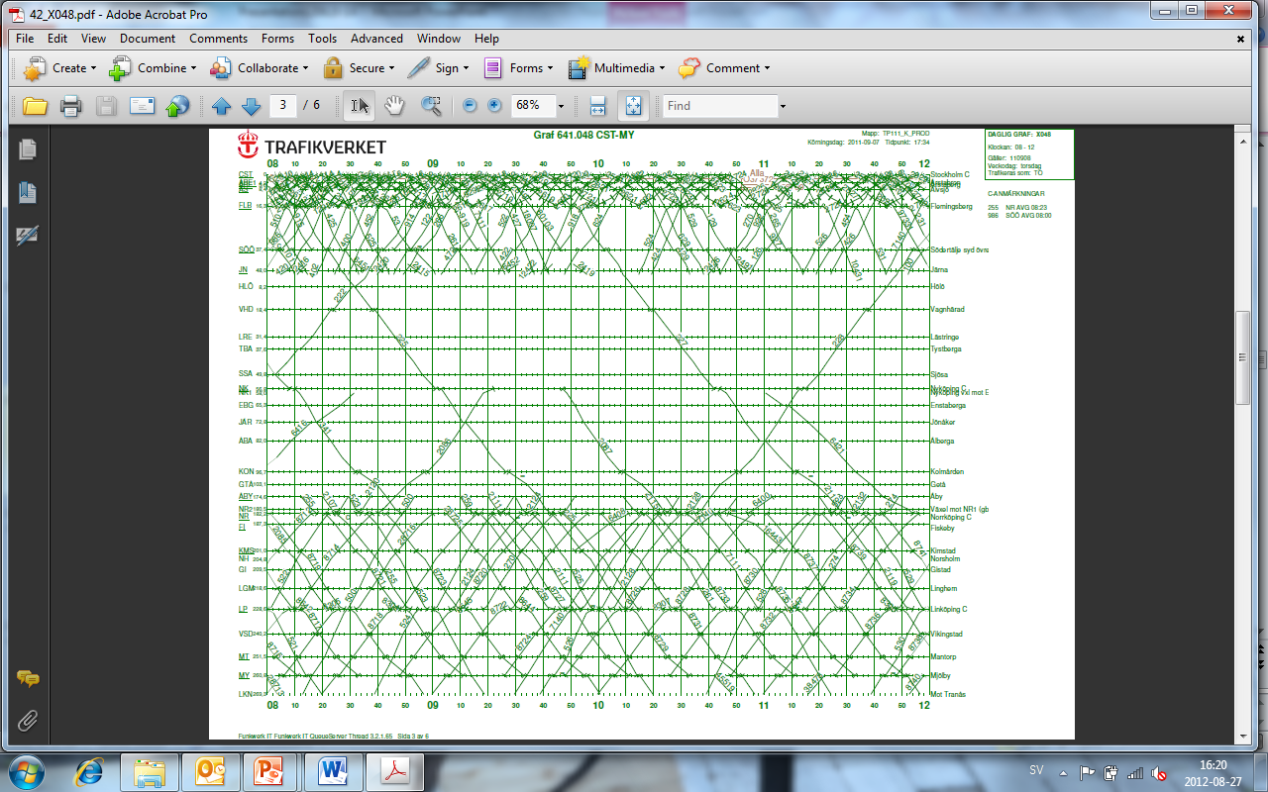
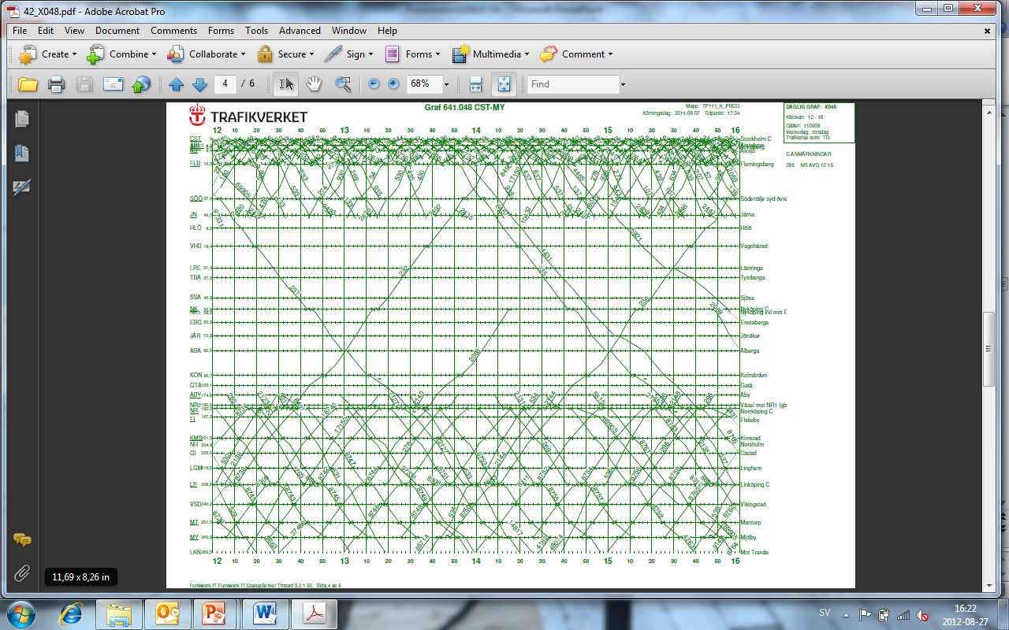
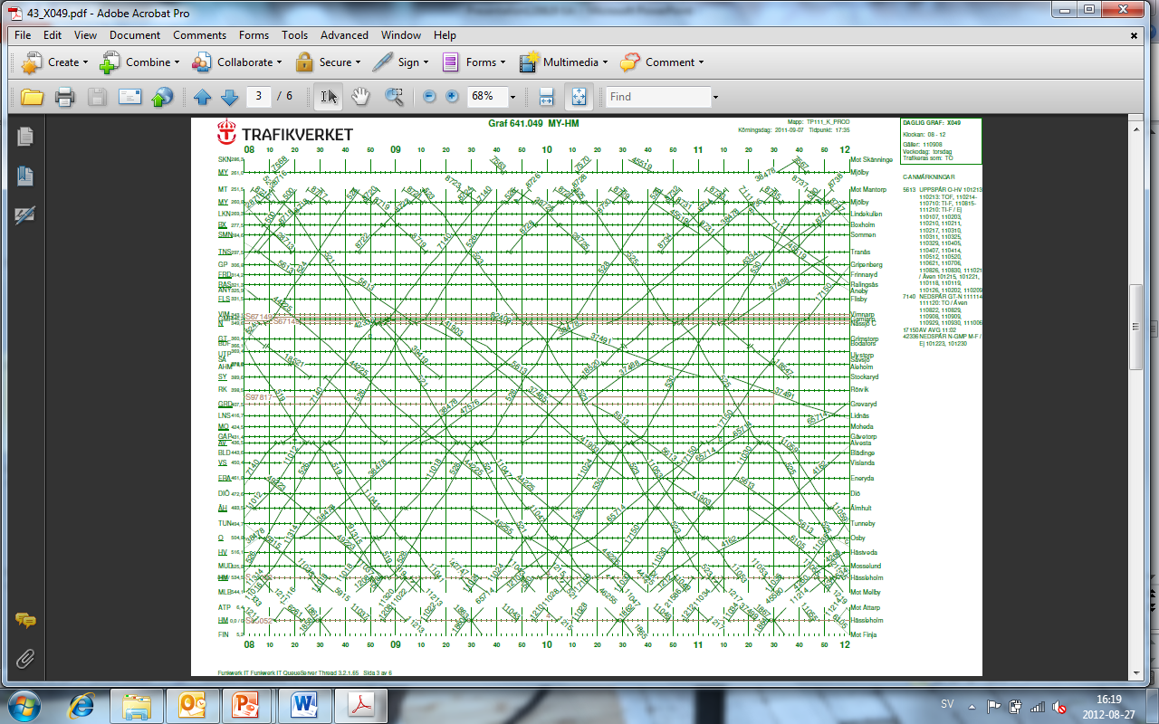
A typical critical point
timetable for train 530 (2011)
Notes:
There are points in the timetable where an already delayed train becomes even more delayed due to short headways and traffic heterogeneity
Trains that end up delayed in these points have trouble to recover from their own delay and will also delay other trains further on
We refer to these points in the timetable as “Critical points”

Slide 3
Robustness in critical points (RCP)
A measure with three parts that indicate how robust a critical point are:
  The available runtime margins for the operating/overtaking train before the critical point
  The available runtime margins for the entering/overtaken train after the critical point.
  The headway margin between the trains in the critical point

Slide 4
The three parts of RCP
E
D
Train 1
Train 2
Stations
C
Runtime margin for train 1 between station A and B
B
Runtime margin for train 2 between station B and C
Headway margin between train 1 and 2 at station B
A
08
10
20
30
40
50
Time

Slide 5
How to increase RCP
Increase some of the three margin parts in the measure
  Might increase the trains’ runtime
  Might lead to a chain of reactions in the timetable
We need a method that can handle all trains at the same time to find the best overall solution
  Mathematical programming, optimization, checks all possible train combinations and result in the optimal timetable

Slide 6
How to increase RCP
Two ways to use RCP in an optimization model
  As an objective function: Maximize RCP
  As a constraint: RCP >= ‘120’ seconds
At the same time the difference to the initial timetable should be as small as possible:
  Minimize T* - T
Evaluate the timetable by simulation with disturbances

Slide 7
Work in progress

Slide 8
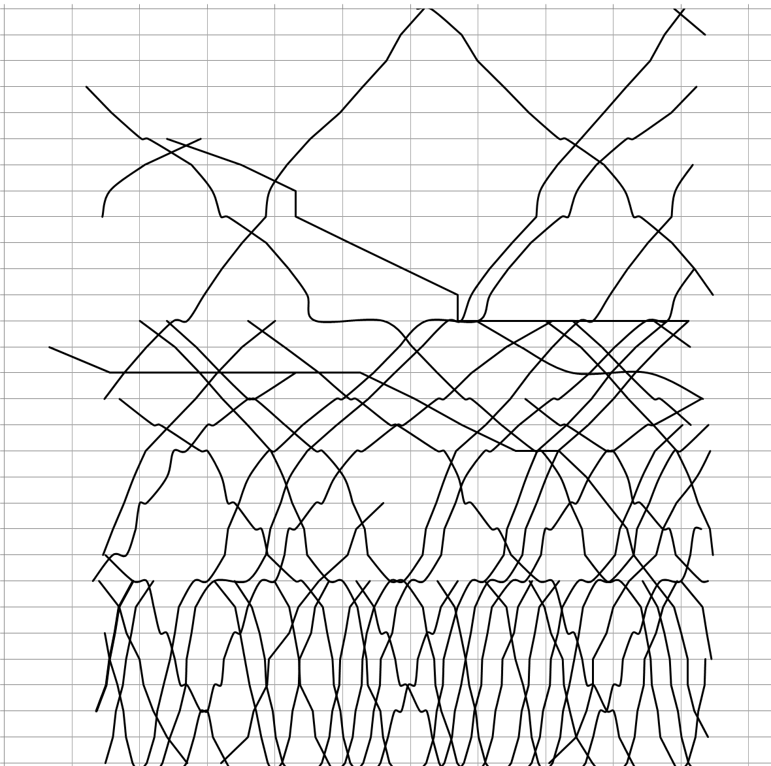
5:30 5:40 5:50 6:00 6:10 6:20 6:30 6:40 6:50 7:00 7:10 7:20
Experiments for the Swedish Southern mainline
Malmö – Alvesta
8th of September 2011
05:45 – 07:15

Slide 9
5:30 5:40 5:50 6:00 6:10 6:20 6:30 6:40 6:50 7:00 7:10 7:20
Critical points
A
Point | RCP (seconds)
A | 0
B | 813
C | 298
D | 325
E | 0
F | 61
G | 512
H | 67
I | 433
J | 110
K | 233
L | 191
B
L
C
E
D
F
G
H
I
J
K
Notes:
Många kritiska punkter vid Lund - sammanfaller med SSHR

Slide 10
Experiments of RCP increase
Restrict RCP by constraints:
  RCP(p) >= 120 sec
  RCP(p) >= 240 sec
  RCP(p) >= 300 sec
Results:
Min RCP | Total travel time increase (sec) | No. of trains with increased travel time | Total change in arr/dep times (sec) | No. of trains with changed arr/dep times
120
240
300

Slide 11
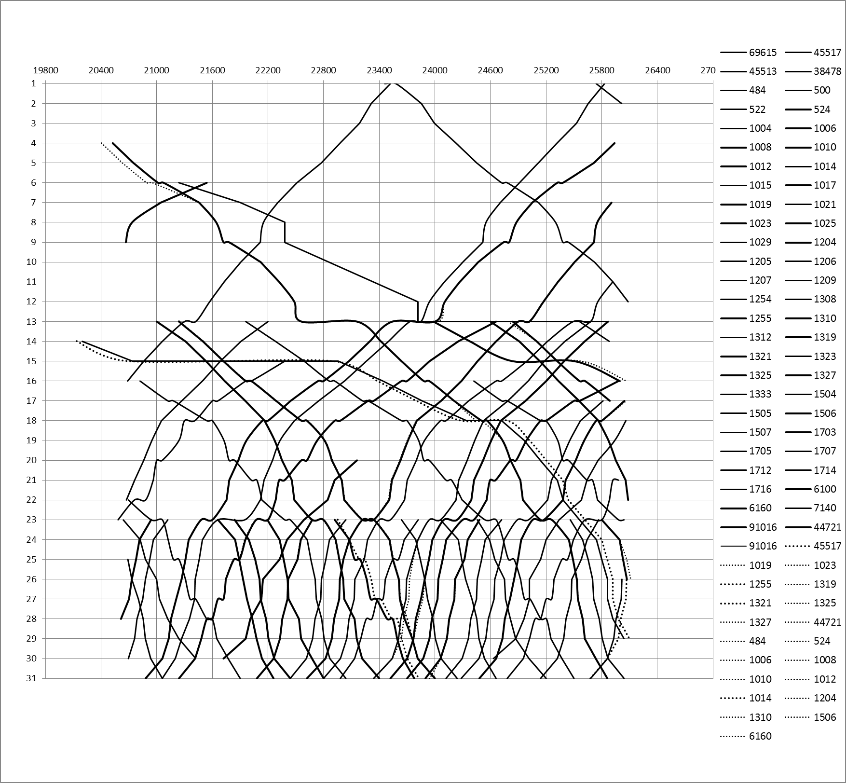
5:30 5:40 5:50 6:00 6:10 6:20 6:30 6:40 6:50 7:00 7:10 7:20
A
RCP (p) >= 120 sec
Point | RCP (sec) | Diff
A | 120 | + 120
B | 813
C | 238 | - 60
D | 325
E | 120 | + 120
F | 121 | +60
G | 512
H | 120 | + 53
I | 433
J | 289 | + 179
K | 277 | + 44
L | 191
B
L
C
E
D
F
G
H
I
J
K

Slide 12
Evaluation of RCP increase
The trains are re-scheduled in the most optimal way, given the timetable flexibility
  The re-scheduling model from EOT is used
  Trains can use both tracks flexible
  Optimal re-scheduling – Does not represent reality
  Objective function: Minimize the difference in dep/arr times at all planned stops
  Solver: CPLEX 12.5
Traffic simulation when a train is delayed at the first station:
  Train 1023 is delayed 120 sec
  Train 1023 is delayed 240 sec
  Train 1023 is delayed 480 sec

Slide 13
Evaluation of RCP increase
Results:
Min RCP | Scenario | Total delay for all trains at all stopping stations (sec) |  | No. of delayed trains at end station |  | No. of delayed arrivals to stops |  | Final delay for the initially delayed train (sec)
0 | 1
 | 2
 | 3
120 | 1
 | 2
 | 3
240 | 1
 | 2
 | 3
300 | 1
 | 2
 | 3
  Scenario 1: Train 1023 is delayed 120 sec
  Scenario 2: Train 1023 is delayed 240 sec
  Scenario 3: Train 1023 is delayed 480 sec
Notes:
Delay = positiv avvikelse från ttb, ( > 0)

Slide 14
Continuing work
Evaluate the timetables with more disturbance scenarios
Test how to maximize RCP in the objective function

Slide 15

Tack för er uppmärksamhet!
Frågor?
emma.andersson@liu.se

