Slide 1
Effects of Travel Time Dependent Headway on Railway Timetable Robustness: an Application to the Swedish Southern Mainline
Anders Peterson
Fahimeh Khoshniyat
Dept. of Science and Technology
Linköping University, Norrköping, Sweden
6th May 2014

Slide 2
Robustness in a railway timetable?
To “deal as well as possible with relatively small disturbances in the real-time operations” (Kroon et al., 2008)
To “avoids delay propagation as much as possible” (Cacchiani et al., 2012)
“Not to be sensitive to disturbances” (Shafia et al., 2012)
To “allow operators to cope with unexpected disruptions” (Salido et al., 2012)
Notes:
There are various definitions for railway robustness.
Initial disturbances can be absorbed to some extent so that they do not lead to delays.
There are few knock-on delays from one train to another.
Delays disappear quickly, possibly with light dispatching measures
Knock on delay or secondary delay : a delay that is imposed to a train by other trains (running in front of it and) sharing the same infrastructural resources.

Slide 3
On-time performance en route
Dotted line = average performance
Doubled line = 75th percentile
Notes:
Train 500.
Analysis for another train also showed the same trend (train 530).

Slide 4
Robust Timetable
Planning Perspective
Strategies
Selecting Measurement Indicators
Applied Methods
Tactical
Operational
Re-scheduling
Optimization
Simulations
Increasing buffer times
Decreasing average speed
Decreasing the capacity usage
Decreasing the heterogeneity
Total Secondary Delays
Average Secondary Delays
Recovery Time
Number of Delayed Trains

Slide 5
Purpose
To implement extra time separation between succeeding trains in a timetable and correlate them with trains’ travel times.
A
1 min / hr or 1,7 %
B
8:00
12:00
Time
Notes:
Define extra buffer time
The longer trains’ travelling time, the larger the extra buffer time
Lost capacity

Slide 6
Implementation Approach
Infrastructure
Existing scheduled timetable
Existing MILP model
Conflict free timetable
Changed MILP model
New calculated timetable with extra time separations
Minimum technical time separation
J. Törnquist Krasemann & J.A. Persson, 2007

Slide 7
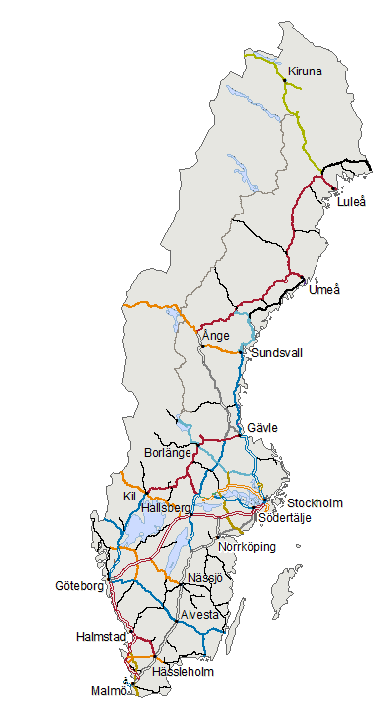
Case study: Swedish Southern Mainline
Alvesta–Lund (a part of the Southern Mainline)
Ca. 200 km long.
Double track.
Mixed traffic, fast and slow passenger trains and cargo.
Timetable period is between 11:00-13:00 and peak afternoon hours 16:00-18:00, regular weekday in 2011 and the same periods in 2014
Source: The Swedish Transport Administration
Notes:
What is the signalling type?

Slide 8
Some preliminary results of the ongoing work…

Slide 9
2011, All trains, Minimum technical headway= 3 min, α =0.03

Slide 10
2011, All trains, Minimum technical headway= 3 min, α =0.03

Slide 11
2011, All trains, Minimum technical headway= 3 min, α =0.03 (extra)

Slide 12
Thank you!
www.liu.se

