Slide 1
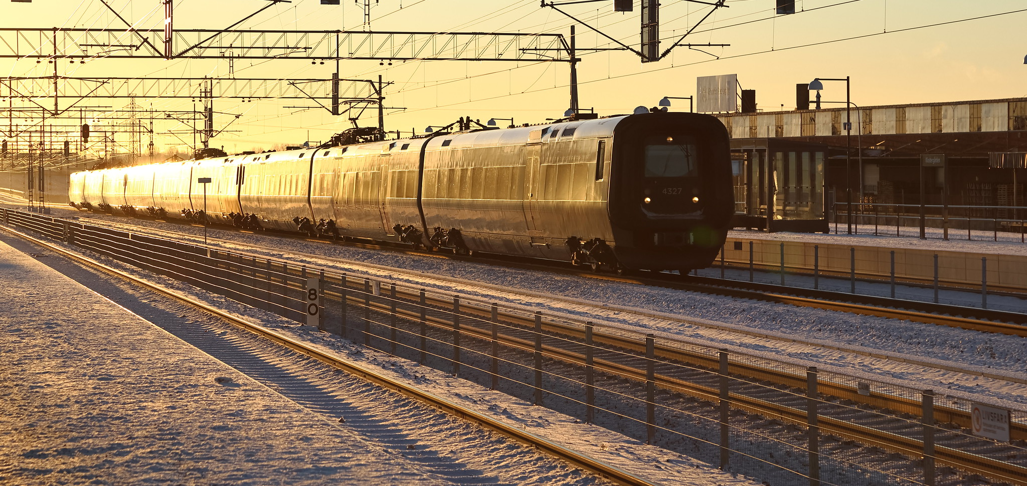


From research results to implementations
Från forskning till tillämpning
About the challenges to implement applications from research results
KAJT
2024-09-18

Slide 2
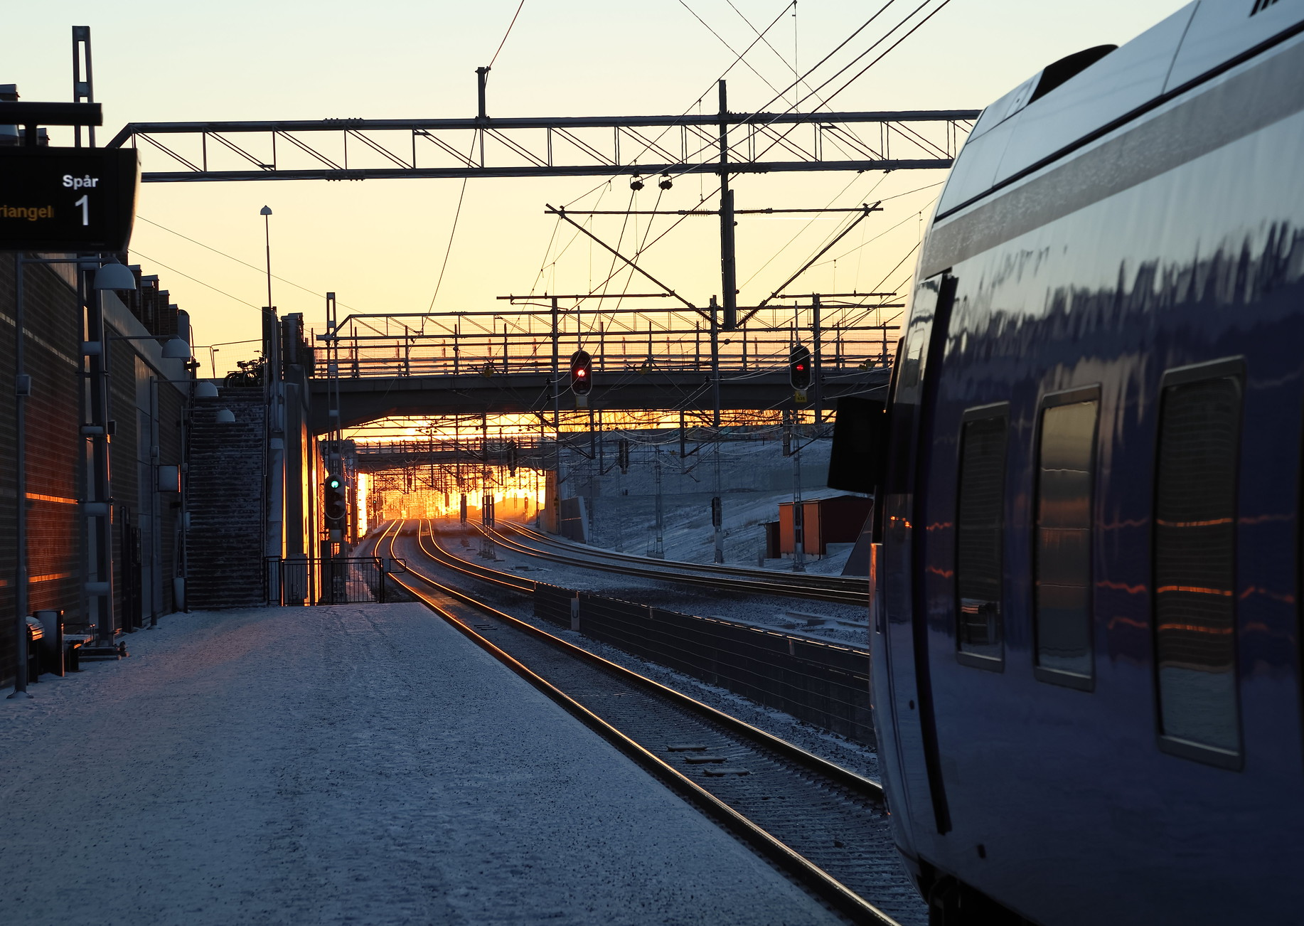
From research results to implementations
– a challange
Implementation of research results into operations in railway business does not happen ”by itself”. Very often it requires a separate process, involving several stakeholders
This document is a summary of aspects to be aware of
Work initiated by KAJT board. Work group consisted of Martin Joborn, Martin Aronsson, Tomas Lidén, Mattias Dahl, Göran Styhr, Magnus Wahlborg

Slide 3


Research process
Different types of result
Ways to spread the result
Report
Publication & Conference paper
Prototype & Demonstrator
Methods & Processes
Algorithm
Knowlegde & Competence
PhD, licentate
Increased maturity (TRL-level)
Research applications (”ansökningar”)
Applications (”tillämpningar”)
…
Seminars
Conferences
Journals
DiVA
Home pages
KAJT Projektkatalog
KAJT Annual report
Reference groups
Workshops w. stakeholders
Collaborations
Industry journals
Education
Professional education
Implementation
…
Research results can be of many different types
Many ways to spread research results
Implemented applications is one type of result and one way of spreading the result
Other result types and way of spreading result are also important
Research and Development need
New research application (”ansökan”)
Project specifi-cation
Research project
Research result
Research idea
Spreading the result

Slide 4
Implemented applications (Tillämpningar)
There are many types of implemented applications
The different types have very different prerequisites to be realized
Implementation process can be easy or complex
Very different prerequisites to be realized:
From simple (like calibrating a value) to complex (like new systems and reorganization)
Different types of applications
Methods and processes
Ideas
Impact on operations
Input to standards
Data and parameters
Systems and tools:
- that industry takes over
- that are further developed by researchers
- that are further developed by system suppliers
Implemented application ”Tillämpning”

Slide 5
Prerequisites for realizing an application
There are several types of prerequisites that needs to be considered, all must be considered
Anyone aiming for realizing research results should be aware of these prerequisites
Research result
Prerequisites for realization
Implementedapplication in railway business
Intrested researcher
Intresserad receiver
Financiation
Commercial conditions
…
Enthusiastic person(s) that can market the idea inside the receiving organization and create needed conditions (finance, development team, receiving organization, …)
Is realization econimically relevant?
Procurement hinders? Immaterial properties? Patents? Process or Organizational adaptations?
…
The researcher must be interested in spending time and efforts in realization
Financies for researcher, dev.team, finetuning, test, implementation, education, …

Slide 6

Summary and conclusion
Implementing research results in railway business can be challenging but rewarding
Implementation needs cooperation
Be aware of needed prerequisities: researcher, receiver, finances, commercial & organizational conditions
Start planning for implementation process long in advance. What are next steps? How to increase maturity? What is required at receiving organization? What is the researcher’s role?
Implementation can have long lead times, can be stepwise. Demonstrations and TRL levels are good supporting tools.

Slide 7



